Slide 1


MP MINI-Project
Smart window control based on temperature and voice
211EC112- G.YASHWANTH KUMAR
211EC138- P.SHASHANKA MOULI

Slide 2
Introduction to THE PROJECT
Automated Window Control System: The project's main objective is to create an advanced window control system that enhances room comfort. It uses a Raspberry Pi 3 Model B+ with Wi-Fi modules for smart control.
Temperature Sensing: The system incorporates a DTH22 temperature sensor and fetches local temperature data from the OpenWeather API. This data is displayed on an LCD screen in the room.
Dynamic Window Operation: The system dynamically adjusts window operations based on temperature differences. Stepper motors control the windows, allowing for airflow regulation.
Voice Control: Users can control the system with voice commands, including open, close, and automate. There are plans to include light intensity and rain detection for further automation.
Automation Hierarchy: The system's hierarchy for control is as follows: Voice-controlled, temperature-controlled for future photosensitive (light intensity), precipitation level (rain).

Slide 3

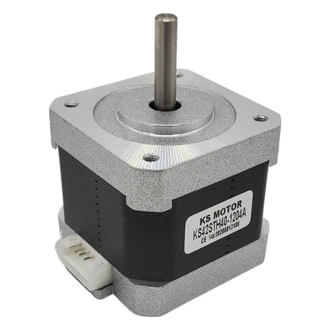
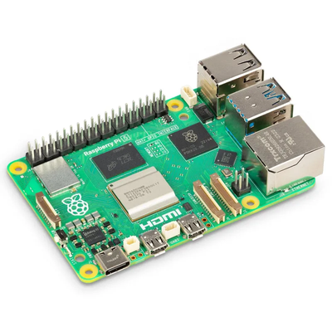

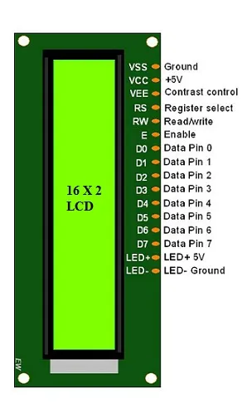
COMPONENTS USED
- Raspberry Pi 3 Model B+
- Temperature Sensor (DHT22)
- OpenWeather API
- LCD Display
- Stepper/Servo Motors
- Voice Recognition System

Slide 4

PROGRESS SO FAR ...
1. Temperature Sensing Integration: Successfully implemented a temperature sensing module using a DTH22 Sensor. Capturing real-time data to monitor the current temperature of the room.
2. OpenWeather API Integration: Integrated the OpenWeatherMap API to fetch accurate and up-to-date temperature data for the city Mulki. Developed a mechanism to handle API requests and responses.
3.Temperature Comparison Algorithm: Implemented a smart algorithm that compares room temperature and city temperature. Defined ranges for triggering actions based on temperature differences.
4. Servo Motor Control: Successfully integrated a servo motor into the system for physical actions.
Designed a control mechanism that adjusts the servo based on temperature variations.
5. Continuous Monitoring and Adjustment: Established a continuous monitoring system to ensure real-time temperature updates. Automated adjustments of the servo motor to maintain optimal conditions.

Slide 5
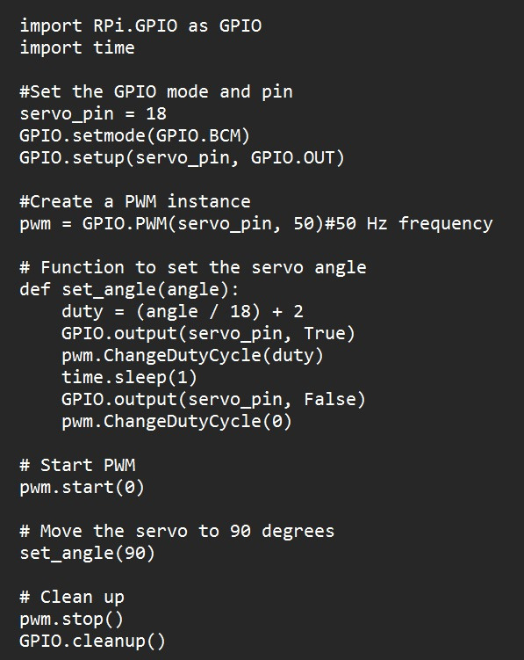
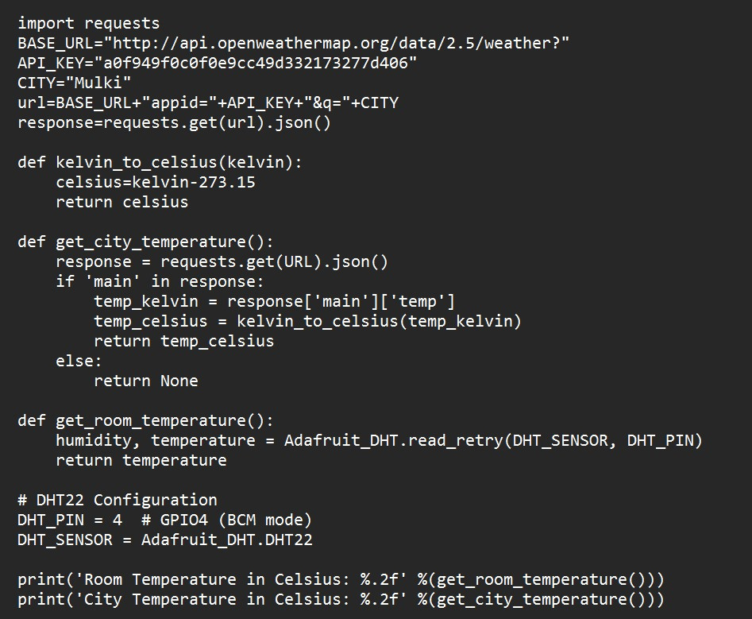
CODES USED FOR THE PROJECT

Slide 6


FUTURE ENHANCEMENTS
Upcoming Features:
1. *Luminous Intensity Detection::Windows respond to light intensity. Too much light triggers window closure for comfort.
2. *Rain Detection:: Windows open/close based on precipitation level. Low to moderate rain prompts window opening; otherwise, it closes.
3. *Hierarchy of Controls:: Voice-controlled commands take precedence. Followed by luminous intensity, precipitation level, and temperature control.

Slide 7
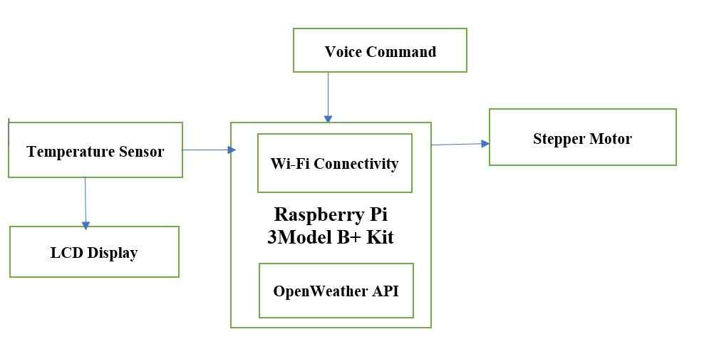

BLOCK-DIAGRAM
THANK YOU

